Slide 1
Chapter 2: Operating-System Structures

Slide 2
Chapter 2: Operating-System Structures
Operating System Services
User Operating System Interface
System Calls
Types of System Calls
System Programs
Operating System Design and Implementation
Operating System Structure
Virtual Machines
Operating System Generation
System Boot

Slide 3
Objectives
Identify services provided by an operating system.
Illustrate how system calls are used to provide operating system services.
Compare and contrast monolithic, layered, microkernel, modular, and hybrid strategies for designing operating systems.
Illustrate the process for booting an operating system.
Apply tools for monitoring operating system performance.
Design and implement kernel modules for interacting with a Linux kernel.

Slide 4
2.1 Operating System Services

Slide 5
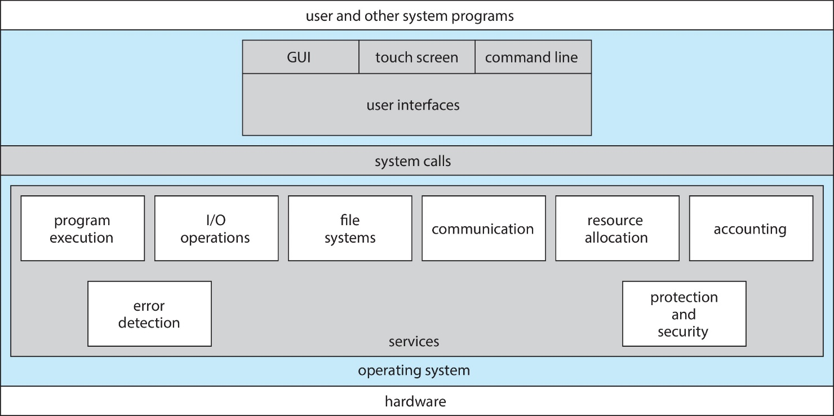
Operating System Services
A view of operating system services.

Slide 6
Operating System Services
One set of operating-system services provides functions that are helpful to the user:
User interface - Almost all operating systems have a user interface (UI)
Varies between Command-Line Interface (CLI), Graphics User Interface (GUI), Batch
Program execution - The system must be able to load a program into memory and to run that program, end execution, either normally or abnormally (indicating error)
I/O operations - A running program may require I/O, which may involve a file or an I/O device.
File-system manipulation - The file system is of particular interest. Obviously, programs need to read and write files and directories, create and delete them, search them, list file Information, permission management.

Slide 7
Operating System Services (Cont.)
One set of operating-system services provides functions that are helpful to the user (Cont):
Communications – Processes may exchange information, on the same computer or between computers over a network
Communications may be via shared memory or through message passing (packets moved by the OS)
Error detection – OS needs to be constantly aware of possible errors
May occur in the CPU and memory hardware, in I/O devices, in user program
For each type of error, OS should take the appropriate action to ensure correct and consistent computing
Debugging facilities can greatly enhance the user’s and programmer’s abilities to efficiently use the system

Slide 8
Operating System Services (Cont.)
Another set of OS functions exists for ensuring the efficient operation of the system itself via resource sharing
Resource allocation - When multiple users or multiple jobs running concurrently, resources must be allocated to each of them
Many types of resources - Some (such as CPU cycles, main memory, and file storage) may have special allocation code, others (such as I/O devices) may have general request and release code.
Accounting - To keep track of which users use how much and what kinds of computer resources
Protection and security - The owners of information stored in a multiuser or networked computer system may want to control use of that information, concurrent processes should not interfere with each other
Protection involves ensuring that all access to system resources is controlled
Security of the system from outsiders requires user authentication, extends to defending external I/O devices from invalid access attempts
If a system is to be protected and secure, precautions must be instituted throughout it. A chain is only as strong as its weakest link.

Slide 9
2.2 User Operating System Interface

Slide 10
User Operating System Interface
Operating System Interface
User Interface （命令接口）
Program Interface （程序接口，system call）
User interface，命令接口- Almost all operating systems have a user interface (UI)
Command-Line Interface (CLI) ，命令行用户接口，文本界面
Graphics User Interface (GUI), 图形用户接口
Touch-Screen Interface，触摸屏接口
Choice of Interface，语音接口
……

Slide 11
User Operating System Interface - CLI
CLI allows direct command entry
Sometimes implemented in kernel, sometimes by systems program
Sometimes multiple flavors implemented – shells
Primarily fetches a command from user and executes it
Sometimes commands built-in, sometimes just names of programs
Linux、UNIX：bash、sh、tcsh

Slide 12
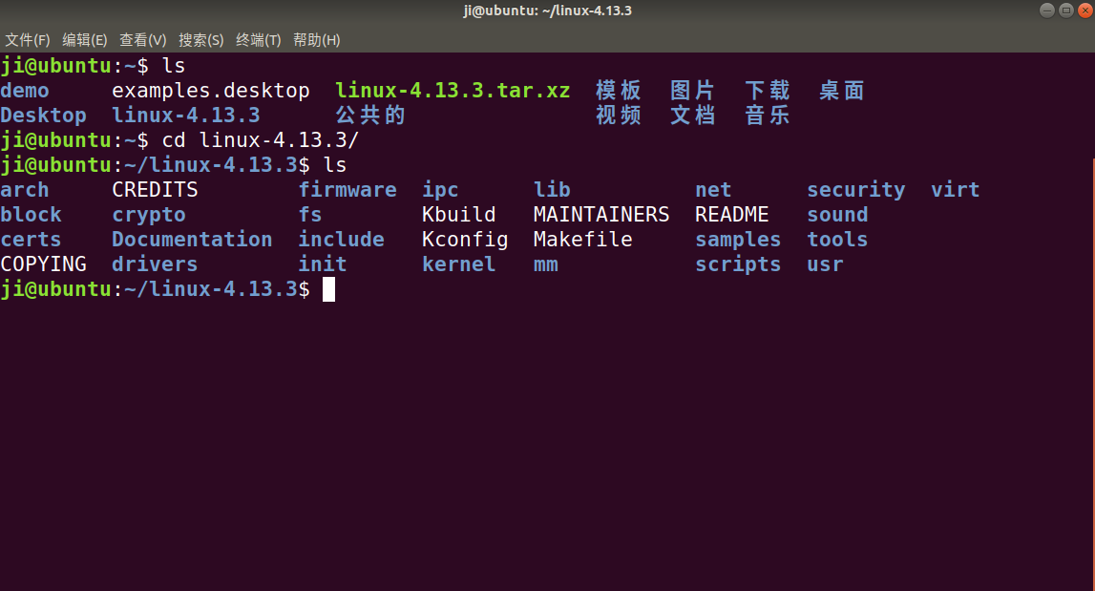
Bourne Shell Command Interpreter

Slide 13
User Operating System Interface - GUI
User-friendly desktop metaphor interface
Usually mouse, keyboard, and monitor
Icons represent files, programs, actions, etc
Various mouse buttons over objects in the interface cause various actions (provide information, options, execute function, open directory (known as a folder)
Invented at Xerox PARC
Many systems now include both CLI and GUI interfaces
Microsoft Windows is GUI with CLI “command” shell
Apple Mac OS X as “Aqua” GUI interface with UNIX kernel underneath and shells available
Solaris is CLI with optional GUI interfaces (Java Desktop, KDE)
Linux

Slide 14
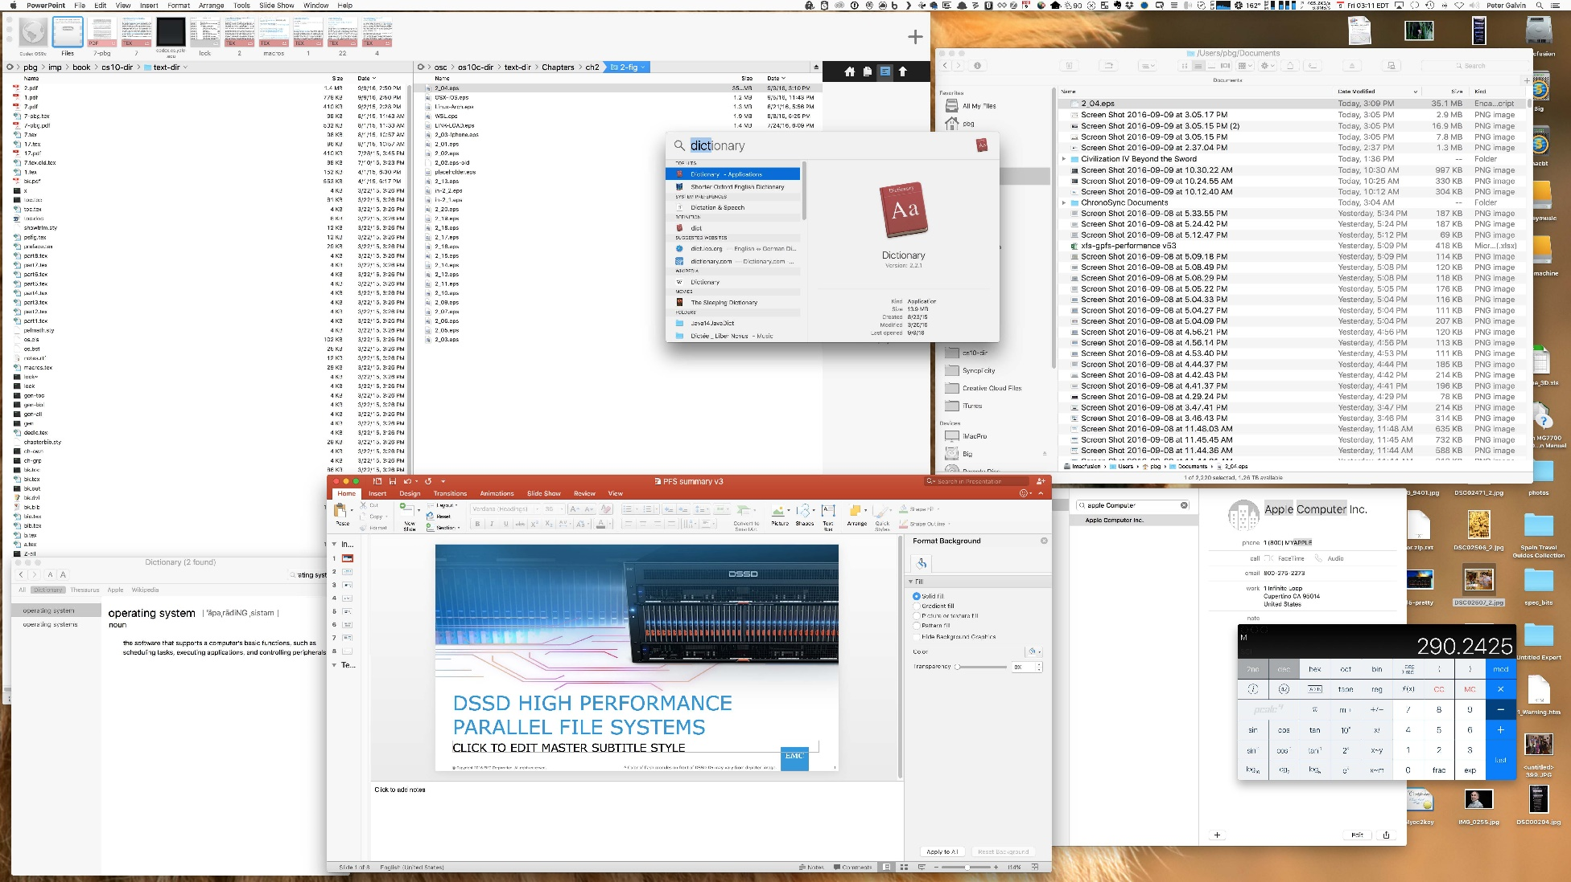
The Mac OS X GUI

Slide 15
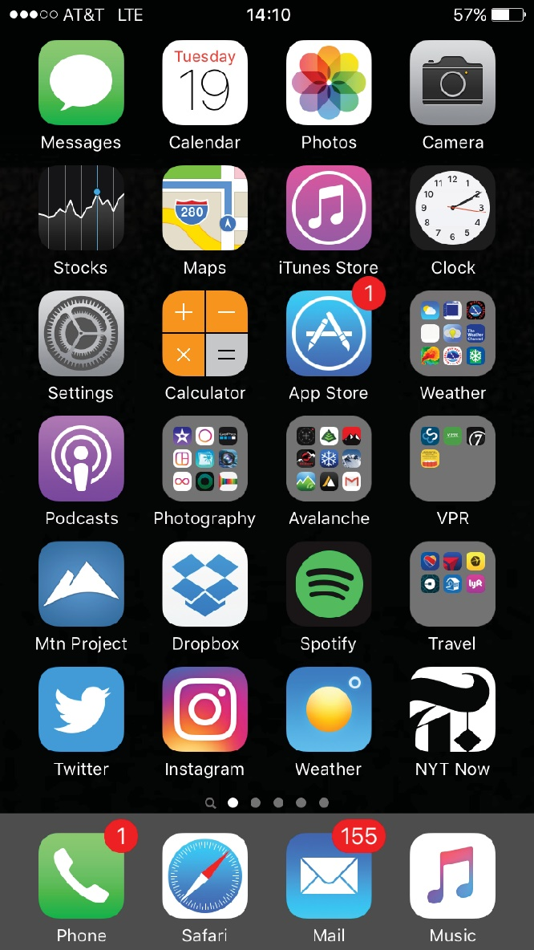
Touchscreen Interfaces
Touchscreen devices require new interfaces
Mouse not possible or not desired
Actions and selection based on gestures
Virtual keyboard for text entry
Voice commands

Slide 16
2.3 System Calls

Slide 17
System Calls（系统调用、程序接口）
System Calls ：Programming interface to the services provided by the OS
System calls are the programming interface between processes and the OS kernel.
Typically written in a high-level language (C or C++)
Mostly accessed by programs via a high-level Application Program Interface (API) rather than direct system call use
Three most common APIs are Win32 API for Windows, POSIX API for POSIX-based systems (including virtually all versions of UNIX, Linux, and Mac OS X), and Java API for the Java virtual machine (JVM)
Why use APIs rather than system calls?
(Note that the system-call names used throughout this text are generic)

Slide 18
系统调用、API和C库
应用编程接口(API)其实是一组函数定义，这些函数说明了如何获得一个给定的服务；而系统调用是通过软中断向内核发出一个明确的请求，每个系统调用对应一个封装例程（wrapper routine，唯一目的就是发布系统调用）。一些API应用了封装例程。
API还包含各种编程接口，如：C库函数、OpenGL编程接口等
系统调用的实现是在内核完成的，而用户态的函数是在函数库中实现的
调用printf()
c库中的printf() c库中的write()
sys_write()系统调用
应用程序 C库 内核

Slide 19
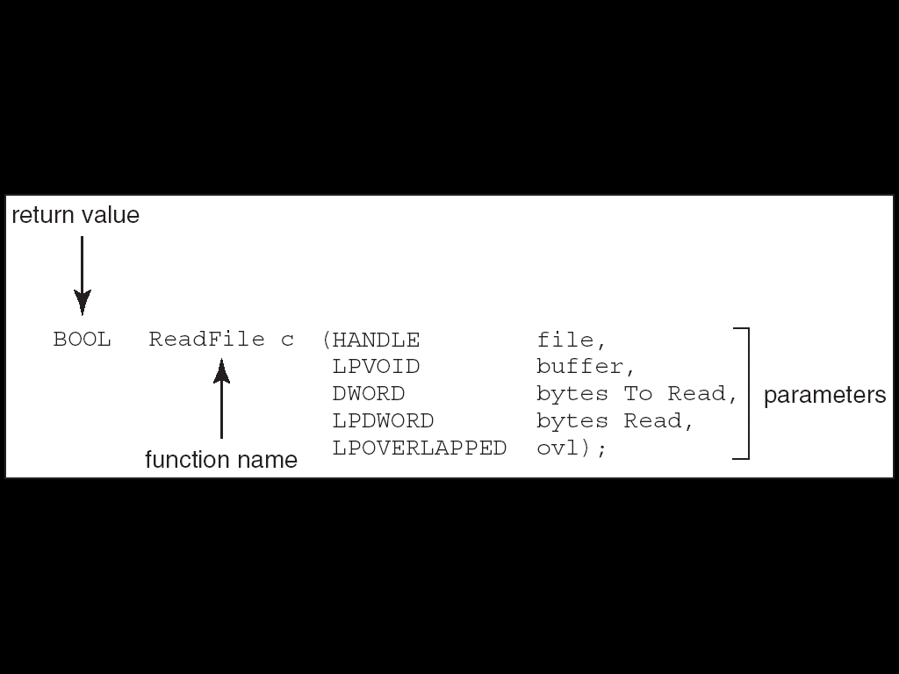
Example of Standard API
Consider the ReadFile() function in the Win32 API—a function for reading from a file
A description of the parameters passed to ReadFile()
HANDLE file—the file to be read
LPVOID buffer—a buffer where the data will be read into and written from
DWORD bytesToRead—the number of bytes to be read into the buffer
LPDWORD bytesRead—the number of bytes read during the last read
LPOVERLAPPED ovl—indicates if overlapped I/O is being used

Slide 20
System Calls
What is a system call?
Informally, a system call is similar to a function call, but…
The function implementation is inside the OS, or we name it the OS kernel.
Function
implementation.
int add_function(int a, int b) {
return (a + b);
}
int main(void) {
int result;
result = add_function(a,b);
return 0;
}
This is a function call.

Slide 21
System Calls
What is a system call?
Calling the kernel to run the “time()” system call.
OS Kernel
Process
time()
The kernel returns the result of “time()”.
A process is running this code.
int main(void) {
time(NULL);
return 0;
}
invoking a system call
Example. The “time()” system call.

Slide 22
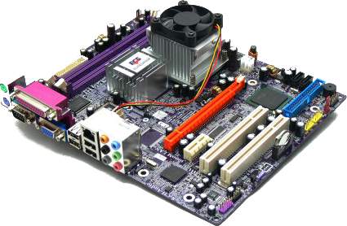
System Calls
I want to know what time it is. So, I write and run this program.
I come to serve!
I’ll call “time()” for you, master.
OK. I’ll ask the hardware clock for the current time.
int main(void) {
time(NULL);
return 0;
}
Operating
System
time()
User
Process
Hardware

Slide 23

System Calls
When do we know if a “function” is a system call?
Read the man page “syscalls” under Linux.
Let’s guess: who are system calls?
Name | System Call?
printf()
malloc()
fopen()
fclose()
No
Who are they?!
No
No
No

Slide 24
System Call vs Library Function Call
If they are not system calls, then they are function calls!
Take fopen() as an example.
fopen() invokes the system call open().
So, why people invented fopen()?
Because open() is too primitive and is not programmer-friendly!
The following two calls have the same effect, but…
Function call
fopen(“hello.txt”, “w”);
System call
open(“hello.txt”, O_WRONLY | O_CREAT | O_TRUNC, 0666);
As a programmer, which one do you prefer?

Slide 25
System Call vs Library Function Call
Those functions are usually packed inside an object called the library file.
$ ls /lib/libc*
/lib/libc-2.9.so ......
$ _
The C standard library file.
OS Kernel
Application
Code
A library
containing the
fopen() function.
open()

Slide 26
System Call Parameter Passing
Often, more information is required than simply identity of desired system call
Exact type and amount of information vary according to OS and call
Three general methods used to pass parameters to the OS
Simplest: pass the parameters in registers
In some cases, may be more parameters than registers
Parameters stored in a block, or table, in memory, and address of block passed as a parameter in a register
This approach taken by Linux and Solaris
Parameters placed, or pushed, onto the stack by the program and popped off the stack by the operating system
Block and stack methods do not limit the number or length of parameters being passed

Slide 27
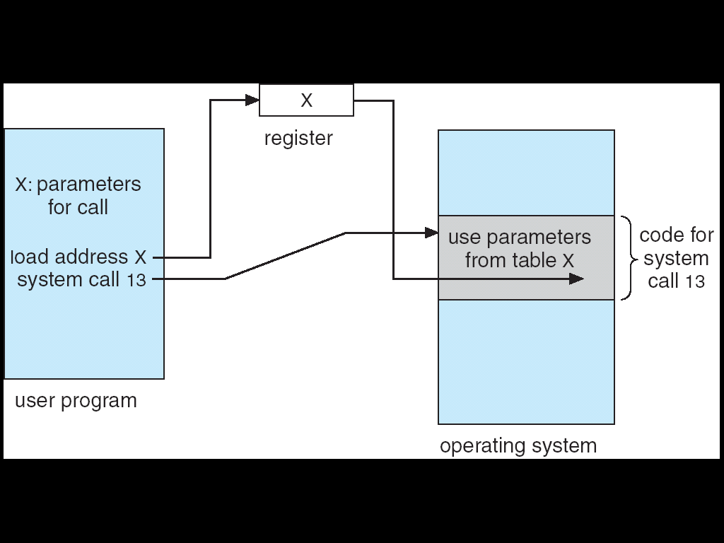
Parameter Passing via Table

Slide 28
Types of System Calls
Process control
File management
Device management
Information maintenance
Communications
Protection
UNIX环境高级编程（第2版），W.Richard Stevens，尤晋元译，人民邮电出版社
Linux/UNIX系统编程手册（上、下册），Michael Kerrisk著，孙剑等译，人民邮电出版社，

Slide 29
Types of System Calls
Process control
create process, terminate process
end, abort
load, execute
get process attributes, set process attributes
wait for time
wait event, signal event
allocate and free memory
Dump memory if error
Debugger for determining bugs, single step execution
Locks for managing access to shared data between processes

Slide 30
Types of System Calls (cont.)
File management
create file, delete file
open, close file
read, write, reposition
get and set file attributes
Device management
request device, release device
read, write, reposition
get device attributes, set device attributes
logically attach or detach devices

Slide 31
Types of System Calls (Cont.)
Information maintenance
get time or date, set time or date
get system data, set system data
get and set process, file, or device attributes
Communications
create, delete communication connection
send, receive messages if message passing model to host name or process name
From client to server
Shared-memory model create and gain access to memory regions
transfer status information
attach and detach remote devices

Slide 32
Types of System Calls (Cont.)
Protection
Control access to resources
Get and set permissions
Allow and deny user access

Slide 33
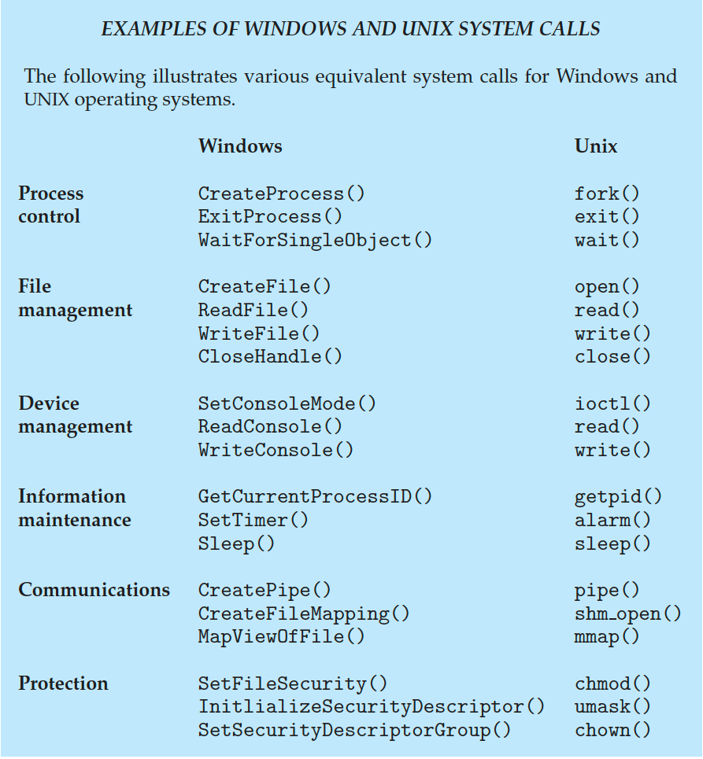
Examples of Windows and Unix System Calls

Slide 34
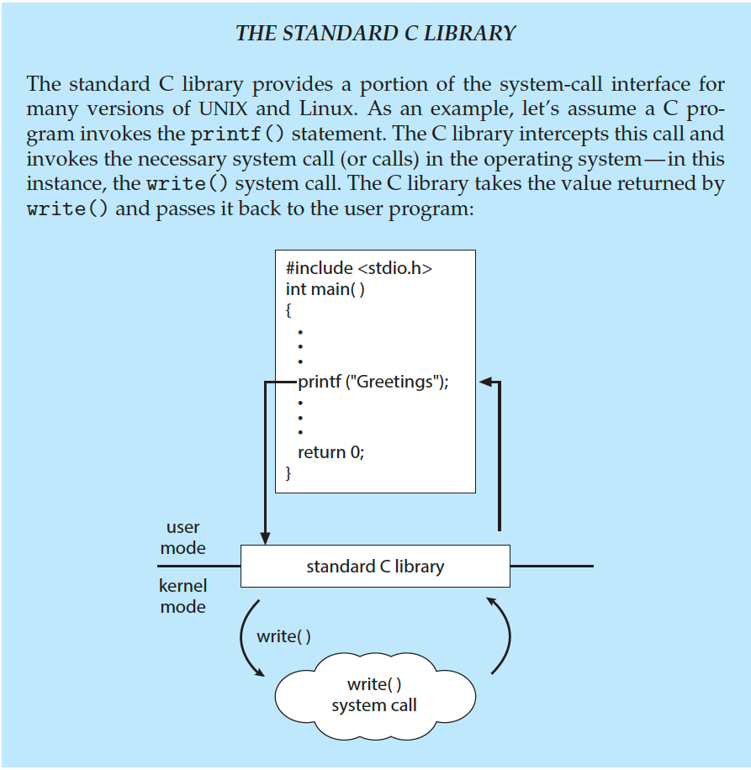
Standard C Library Example
C program invoking printf() library call, which calls write() system call

Slide 35
2.4 System Services

Slide 36
System Services
System programs provide a convenient environment for program development and execution. They can be divided into:
File manipulation
Status information
File modification
Programming language support
Program loading and execution
Communications
Application programs
Most users’ view of the operation system is defined by system programs, not the actual system calls
如：Linux/Unix各种命令（程序）

Slide 37
System Services (cont.)
Provide a convenient environment for program development and execution
Some of them are simply user interfaces to system calls; others are considerably more complex
File management - Create, delete, copy, rename, print, dump, list, and generally manipulate files and directories
Status information
Some ask the system for info - date, time, amount of available memory, disk space, number of users
Others provide detailed performance, logging, and debugging information
Typically, these programs format and print the output to the terminal or other output devices
Some systems implement a registry - used to store and retrieve configuration information

Slide 38
System Services (cont.)
File modification
Text editors to create and modify files
Special commands to search contents of files or perform transformations of the text
Programming-language support - Compilers, assemblers, debuggers and interpreters sometimes provided
Program loading and execution- Absolute loaders, relocatable loaders, linkage editors, and overlay-loaders, debugging systems for higher-level and machine language
Communications - Provide the mechanism for creating virtual connections among processes, users, and computer systems
Allow users to send messages to one another’s screens, browse web pages, send electronic-mail messages, log in remotely, transfer files from one machine to another

Slide 39
System Services (Cont.)
Background Services
Launch at boot time
Some for system startup, then terminate
Some from system boot to shutdown
Provide facilities like disk checking, process scheduling, error logging, printing
Run in user context not kernel context
Known as services, subsystems, daemons
Application programs
Don’t pertain to system
Run by users
Not typically considered part of OS
Launched by command line, mouse click, finger poke

Slide 40
2.5 Linkers and Loaders

Slide 41
Linkers and Loaders
Source code compiled into object files designed to be loaded into any physical memory location – relocatable object file
Linker combines these into single binary executable file
Also brings in libraries
Program resides on secondary storage as binary executable
Must be brought into memory by loader to be executed
Relocation assigns final addresses to program parts and adjusts code and data in program to match those addresses

Slide 42
Linkers and Loaders
Modern general purpose systems don’t link libraries into executables
Rather, dynamically linked libraries (in Windows, DLLs) are loaded as needed, shared by all that use the same version of that same library (loaded once)
Object, executable files have standard formats, so operating system knows how to load and start them

Slide 43
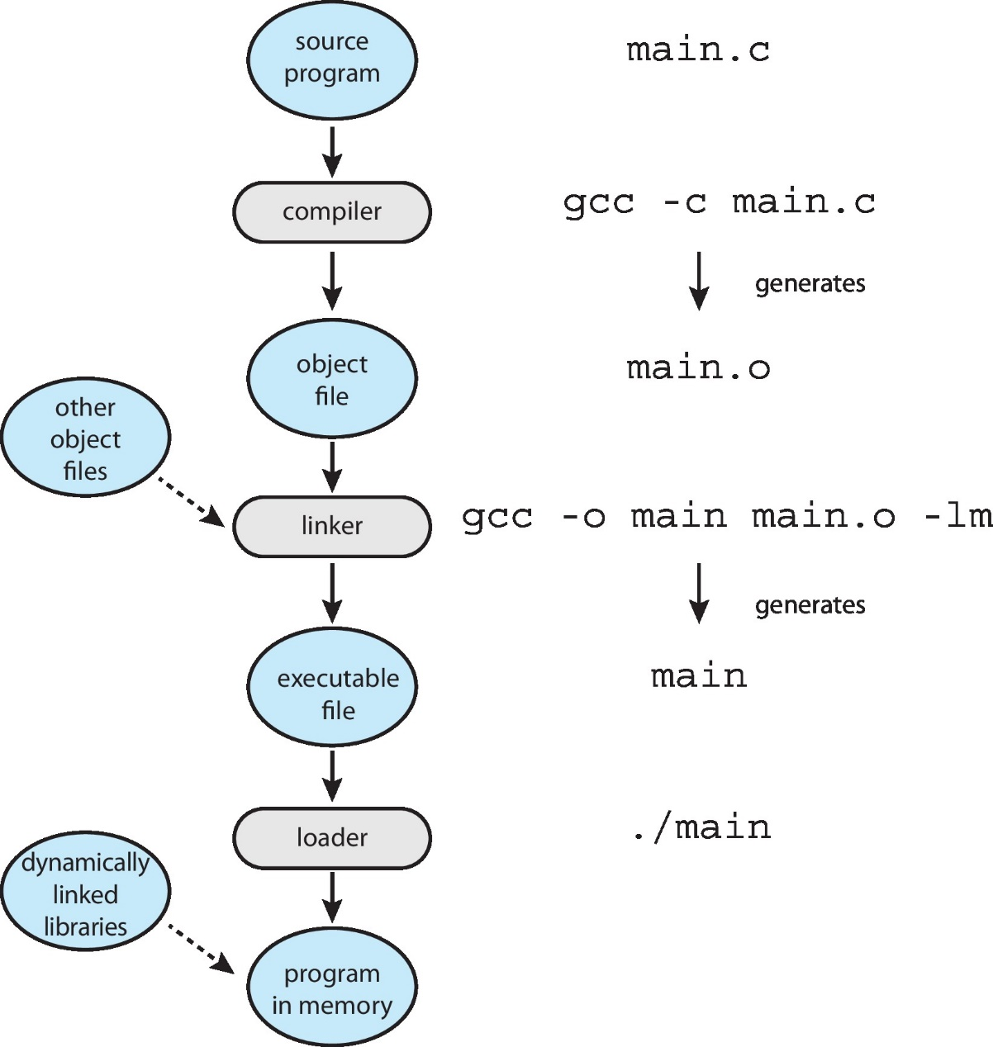
The Role of the Linker and Loader

Slide 44
2.6 Why Applications Are Operating-System Specific (为什么应用程序只运行在特定的操作系统上)
Notes:
为什么应用程序试运行在特定的操作系统上

Slide 45
Why Applications are Operating System Specific
Apps compiled on one system usually not executable on other operating systems
Each operating system provides its own unique system calls
Own file formats, etc
Apps can be multi-operating system
Written in interpreted language like Python, Ruby, and interpreter available on multiple operating systems
App written in language that includes a VM containing the running app (like Java)
Use standard language (like C), compile separately on each operating system to run on each
同一个应用程序如何在不同的操作系统上运行？

Slide 46
Why Applications are Operating System Specific
Application Binary Interface (ABI) is architecture equivalent of API, defines how different components of binary code can interface for a given operating system on a given architecture, CPU, etc

Slide 47
2.7 Operating-System Design and Implementation

Slide 48
Operating System Design and Implementation
Design and Implementation of OS not “solvable”, but some approaches have proven successful
Internal structure of different Operating Systems can vary widely
Start by defining goals and specifications
Affected by choice of hardware, type of system
User goals and System goals
User goals – operating system should be convenient to use, easy to learn, reliable, safe, and fast
System goals – operating system should be easy to design, implement, and maintain, as well as flexible, reliable, error-free, and efficient

Slide 49
操作系统的设计问题
操作系统设计有着不同于一般应用系统设计的特征：
复杂程度高
研制周期长
正确性难以保证
Windows 2000开发的艰辛与规模
最早Uinx是1400行代码；
Windows xp有4000万行代码；
fedroa core有2亿多行代码，Linux kernel 4.10有2千多万行代码。
解决途径：
良好的操作系统结构
先进的开发方法和工程化的管理方法（软件工程）
高效的开发工具

Slide 50
Operating System Design and Implementation (Cont.)
Important principle to separate
Policy策略: What will be done? Mechanism机制: How to do it?
Mechanisms determine how to do something, policies decide what will be done
The separation of policy from mechanism is a very important principle, it allows maximum flexibility if policy decisions are to be changed later

Slide 51
操作系统的设计考虑
功能设计：操作系统应具备哪些功能
算法设计：选择和设计满足系统功能的算法和策略，并分析和估算其效能
结构设计：选择合适的操作系统结构
按照系统的功能和特性要求，选择合适的结构，使用相应的结构设计方法将系统逐步地分解、抽象和综合，使操作系统结构清晰、简单、可靠、易读、易修改，而且使用方便，适应性强

Slide 52
Implementation
Much variation
Early OSes in assembly language
Then system programming languages like Algol, PL/1
Now C, C++
Actually usually a mix of languages
Lowest levels in assembly
Main body in C
Systems programs in C, C++, scripting languages like PERL, Python, shell scripts
More high-level language easier to port to other hardware
But slower
Emulation can allow an OS to run on non-native hardware

Slide 53
2.8 Operating-System Structure

Slide 54
2.7 Operating-System Structure
Simple Structure简单结构
Layered Approach层次化结构
Monolithic Kernels Structure单/宏内核结构
Microkernel 微内核
Modules 模块
Hybrid Systems 混合结构
Virtual Machines 虚拟机

Slide 55
一、Simple Structure（简单结构）
MS-DOS – written to provide the most functionality in the least space
Not divided into modules
Although MS-DOS has some structure, its interfaces and levels of functionality are not well separated

Slide 56
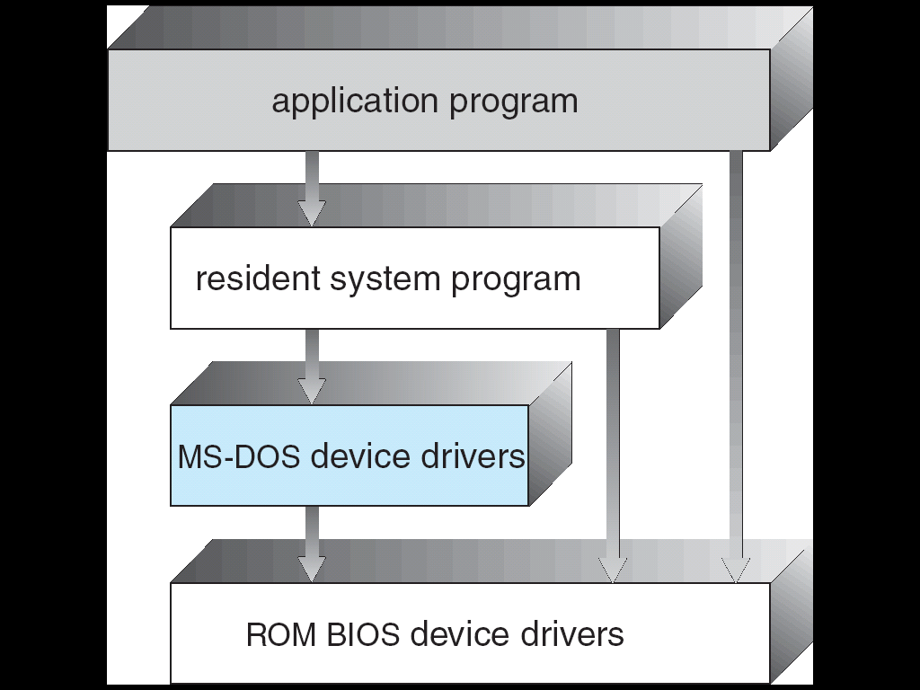
MS-DOS Structure

Slide 57
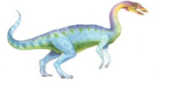
二、Layered Approach（层次结构）
The operating system is divided into a number of layers (levels), each built on top of lower layers. The bottom layer (layer 0), is the hardware; the highest (layer N) is the user interface.
With modularity, layers are selected such that each uses functions (operations) and services of only lower-level layers

Slide 58
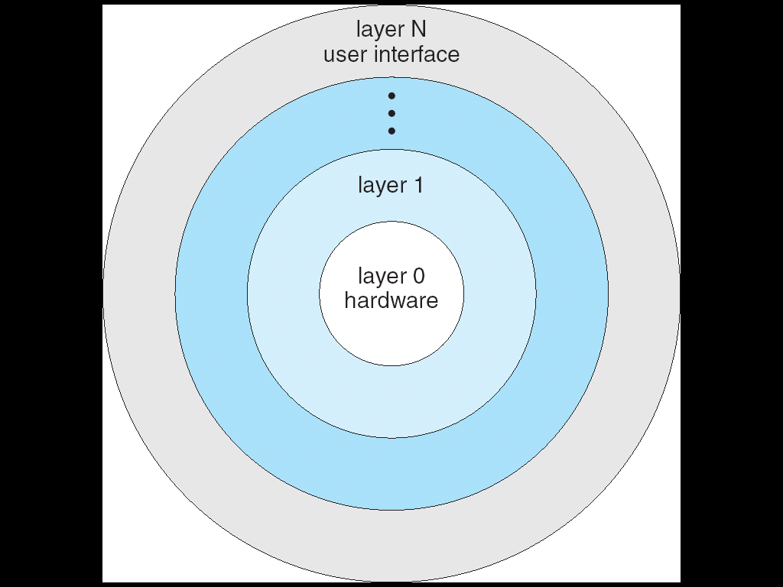
Layered Operating System

Slide 59
三、Monolithic Structure（单/宏内核结构）
Monolithic Kernels ：the entire code of the kernel — including all its subsystems such as memory management, file systems, or device drivers — is packed into a single file. Each function has access to all other parts of the kernel;
Earliest and most common OS architecture (UNIX)
Every component of the OS is contained in the Kernel
Examples: OS/360, VMS and Linux

Slide 60
Monolithic Structure
Advantages:
highly efficient because of direct communication between components
Disadvantages:
Difficult to isolate source of bugs and other errors
Hard to modify and maintain
Kernel gets bigger as the OS develops.

Slide 61
Monolithic Structure– Original UNIX
UNIX – limited by hardware functionality, the original UNIX operating system had limited structuring. The UNIX OS consists of two separable parts
Systems programs
The kernel
Consists of everything below the system-call interface and above the physical hardware
Provides the file system, CPU scheduling, memory management, and other operating-system functions; a large number of functions for one level

Slide 62
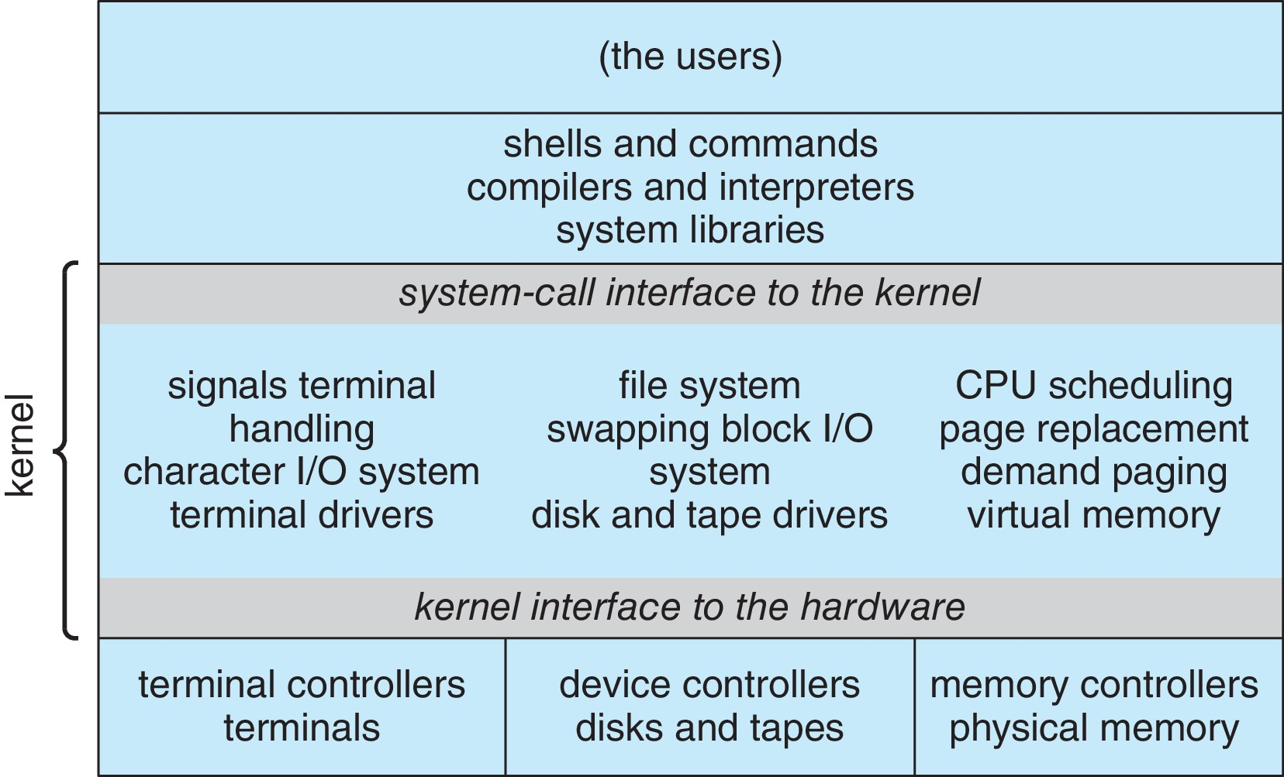
Traditional UNIX System Structure
Beyond simple but not fully layered

Slide 63
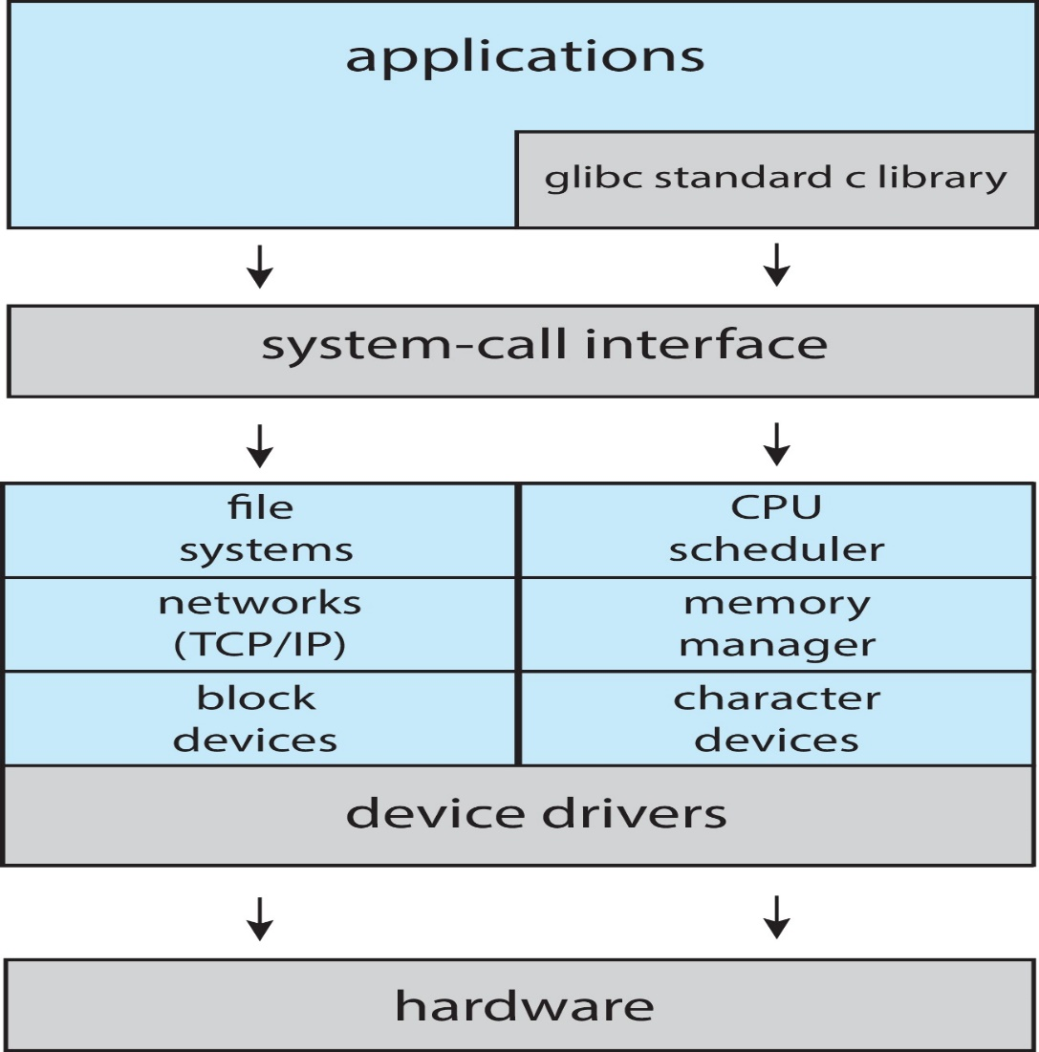
Linux System Structure
Monolithic plus modular design

Slide 64
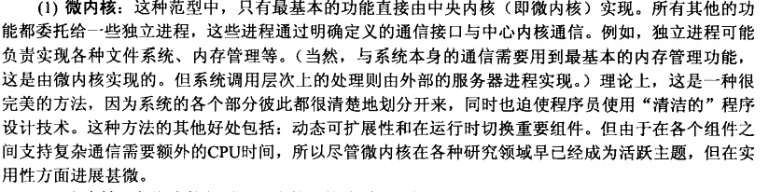
四、Microkernel System Structure （微内核结构）
Microkernels — only the most elementary functions are implemented directly in a central kernel— the microkernel. All other functions are delegated to autonomous processes that communicate with the central kernel via clearly defined communication interfaces
由下面两大部分组成 ：
“微”内核
若干服务
Moves as much from the kernel into “user” space
Communication takes place between user modules using message passing

Slide 65
Microkernel System Structure （微内核结构）
Benefits:
Easier to extend a microkernel
Easier to port the operating system to new architectures
More reliable (less code is running in kernel mode)
More secure
Detriments:
Performance overhead of user space to kernel space communication
Windows NT ... Windows 8、Windows 10、Mac OS
L4 ： http://www.l4hq.org/

Slide 66
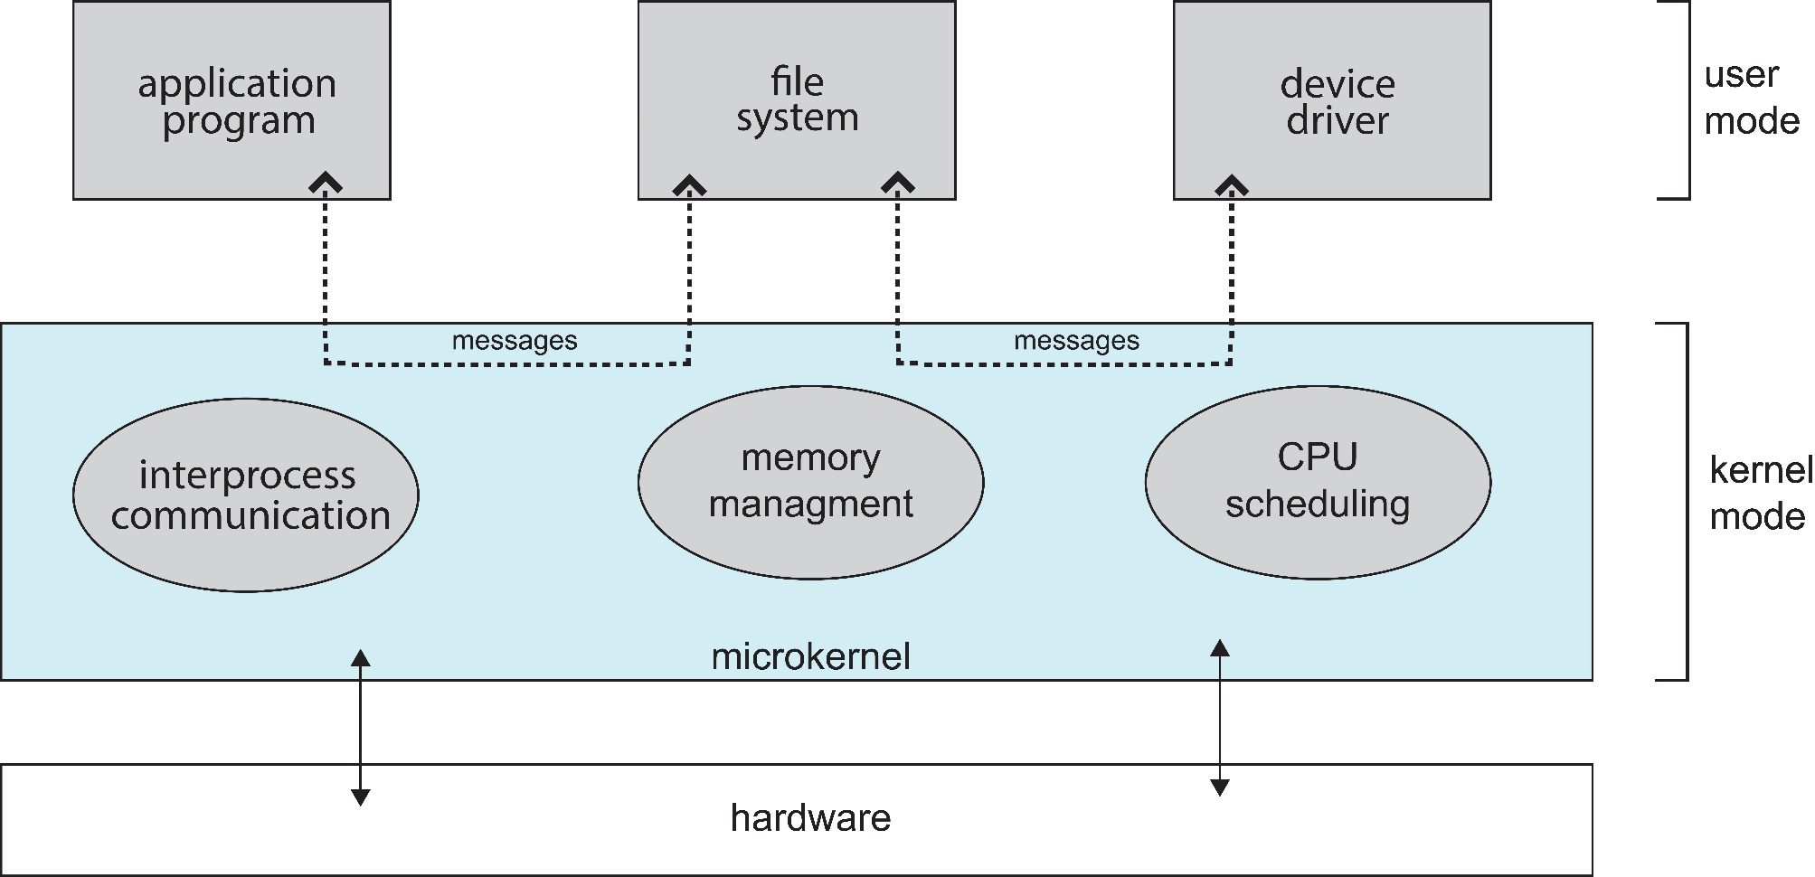
Microkernel System Structure

Slide 67
Windows Kernel
Windows NT 4.0 起，采用 microkernel 的架构

Slide 68
五、Modules（模块）
Most modern operating systems implement kernel modules （内核模块）
Uses object-oriented approach
Each core component is separate
Each talks to the others over known interfaces
Each is loadable as needed within the kernel
Overall, similar to layers but with more flexible
Linux , Solaris, etc

Slide 69
六、Hybrid Systems（混合系统）
Most modern operating systems actually not one pure model
Hybrid combines multiple approaches to address performance, security, usability needs
Linux and Solaris kernels in kernel address space, so monolithic, plus modular for dynamic loading of functionality
Windows mostly monolithic, plus microkernel for different subsystem personalities
Apple Mac OS X hybrid, layered, Aqua UI plus Cocoa programming environment
Below is kernel consisting of Mach microkernel and BSD Unix parts, plus I/O kit and dynamically loadable modules (called kernel extensions)

Slide 70
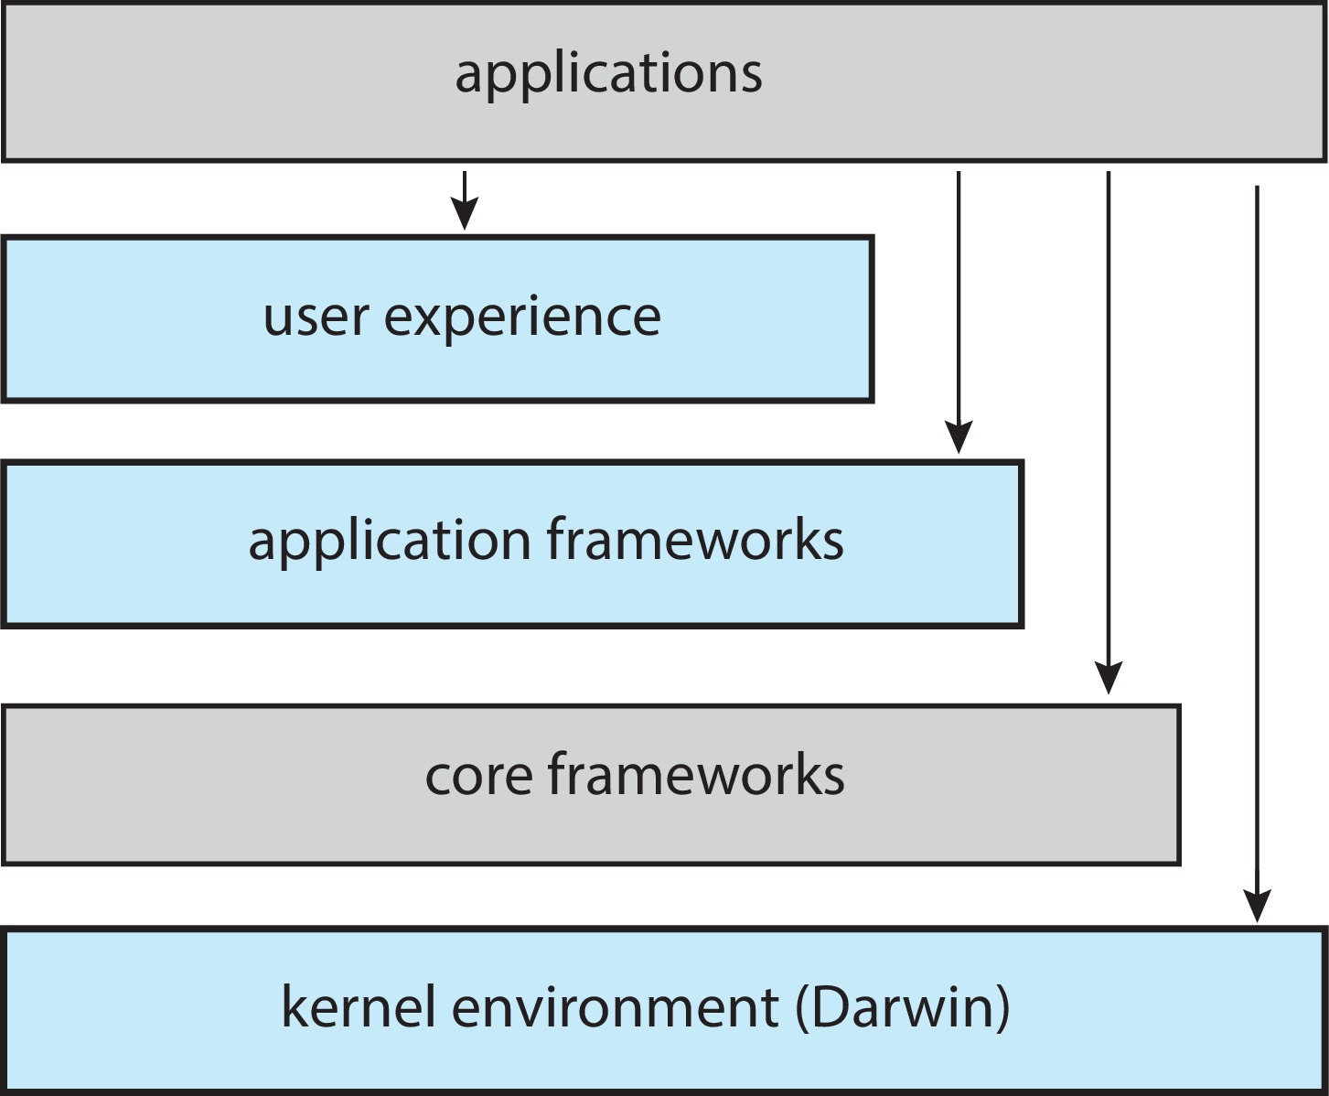
macOS and iOS Structure

Slide 71
iOS
Apple mobile OS for iPhone, iPad
Structured on Mac OS X, added functionality
Does not run OS X applications natively
Also runs on different CPU architecture (ARM vs. Intel)
Cocoa Touch Objective-C API for developing apps
Media services layer for graphics, audio, video
Core services provides cloud computing, databases
Core operating system, based on Mac OS X kernel

Slide 72
Android
Developed by Open Handset Alliance (mostly Google)
Open Source
Similar stack to IOS
Based on Linux kernel but modified
Provides process, memory, device-driver management
Adds power management
Runtime environment includes core set of libraries and Dalvik virtual machine
Apps developed in Java plus Android API
Java class files compiled to Java bytecode then translated to executable than runs in Dalvik VM
Libraries include frameworks for web browser (webkit), database (SQLite), multimedia, smaller libc

Slide 73
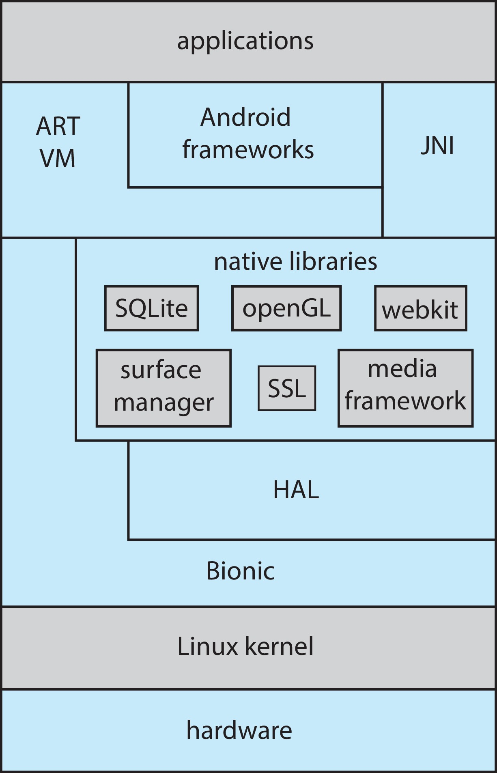
Android Architecture

Slide 74
七、Virtual Machines
A virtual machine takes the layered approach to its logical conclusion. It treats hardware and the operating system kernel as though they were all hardware
A virtual machine provides an interface identical to the underlying bare hardware
The operating system host creates the illusion that a process has its own processor and (virtual memory)
Each guest provided with a (virtual) copy of underlying computer
virtual machine software： VMWARE、 VirtualBox 、Microsoft Virtual PC
OpenStack云计算平台

Slide 75
Virtual Machines (Cont.)
The resources of the physical computer are shared to create the virtual machines
CPU scheduling can create the appearance that users have their own processor
Spooling and a file system can provide virtual card readers and virtual line printers
A normal user time-sharing terminal serves as the virtual machine operator’s console

Slide 76
Virtual Machines (Cont.)
The virtual-machine concept provides complete protection of system resources since each virtual machine is isolated from all other virtual machines. This isolation, however, permits no direct sharing of resources.
A virtual-machine system is a perfect vehicle for operating-systems research and development. System development is done on the virtual machine, instead of on a physical machine and so does not disrupt normal system operation.
The virtual machine concept is difficult to implement due to the effort required to provide an exact duplicate to the underlying machine

Slide 77
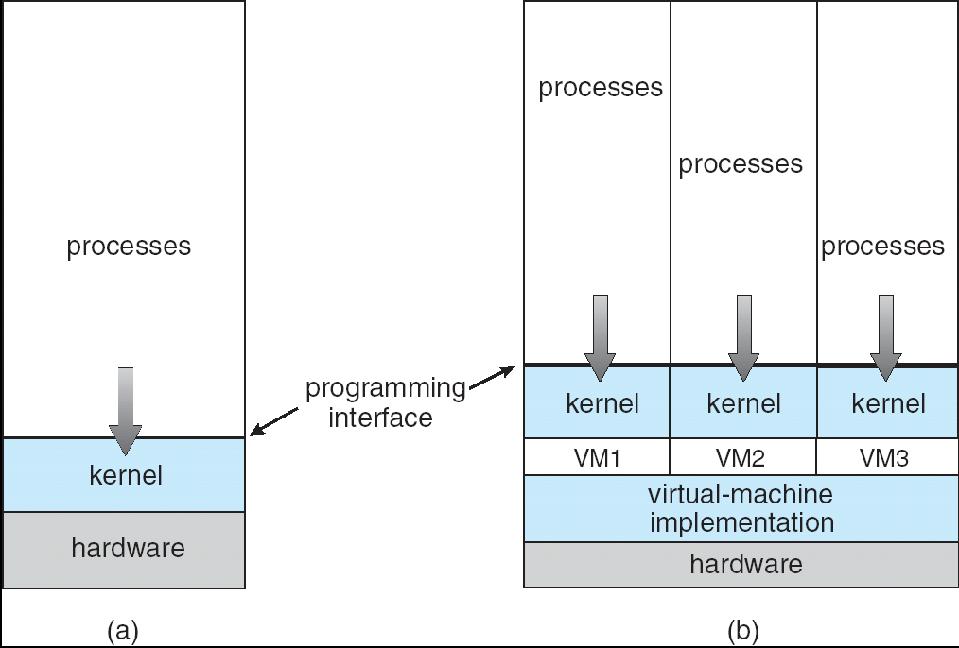
Virtual Machines (Cont.)
(a) Nonvirtual machine (b) virtual machine
Non-virtual Machine
Virtual Machine

Slide 78
Para-virtualization（“半虚拟化”）
Presents guest with system similar but not identical to hardware
Guest must be modified to run on paravirtualized hardware
Guest can be an OS, or in the case of Solaris 10 applications running in containers

Slide 79
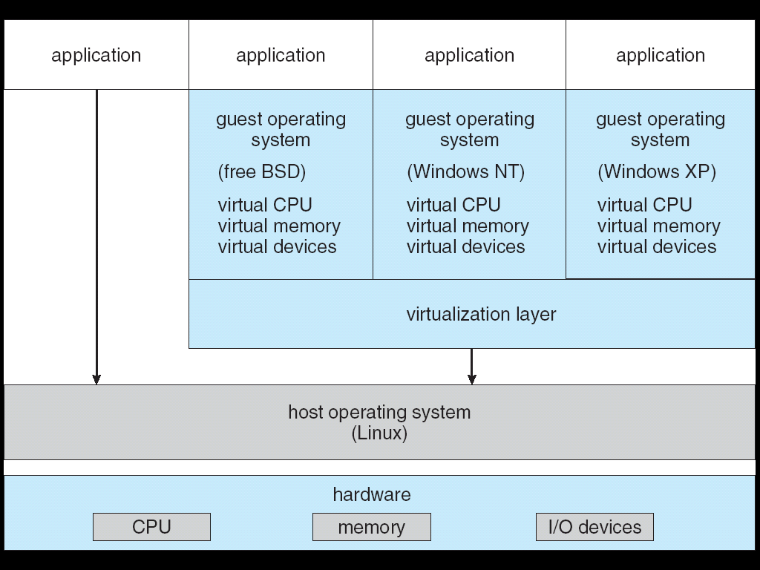
VMware Architecture

Slide 80
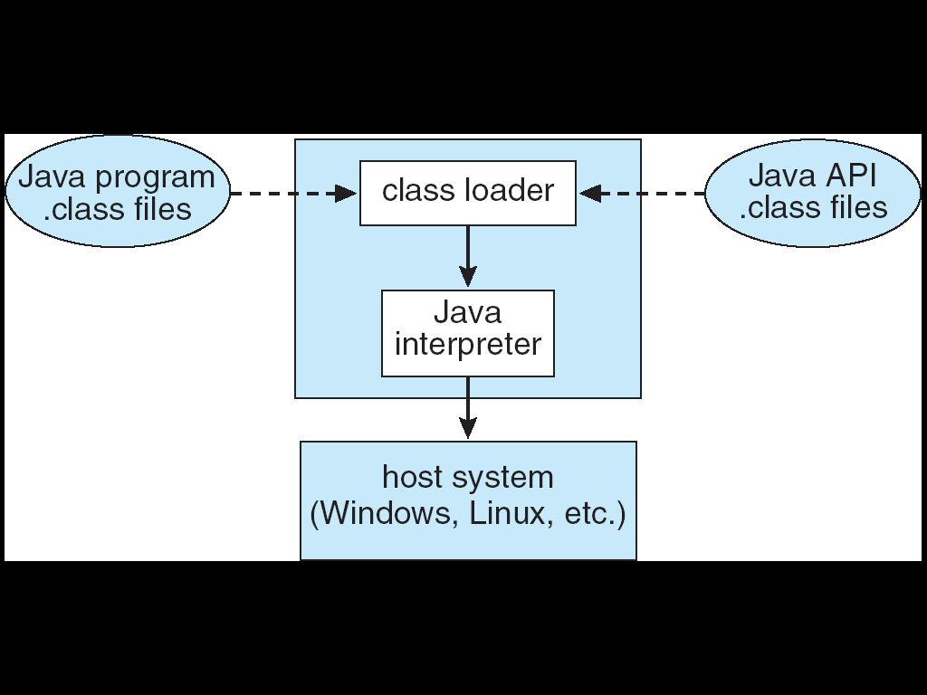
The Java Virtual Machine

Slide 81
2.9 Building and Booting an Operating System

Slide 82
Building and Booting an Operating System
Operating systems generally designed to run on a class of systems with variety of perpherals
Commonly, operating system already installed on purchased computer
But can build and install some other operating systems
If generating an operating system from scratch
Write the operating system source code
Configure the operating system for the system on which it will run
Compile the operating system
Install the operating system
Boot the computer and its new operating system

Slide 83
Building and Booting Linux
Download Linux source code (http://www.kernel.org)
Configure kernel via “make menuconfig”
Compile the kernel using “make”
Produces vmlinuz, the kernel image
Compile kernel modules via “make modules”
Install kernel modules into vmlinuz via “make modules_install”
Install new kernel on the system via “make install”

Slide 84
WINDOWS 启动
ROM中POST（Power On Self-Test）代码
BIOS/EFI（Extended Firmware Interface）
MBR(Main Boot Record)
引导扇区(Boot sector)
NTLDR/WinLoad
NTOSKRNL/HAL/BOOTVID/KDCOM
SMSS.EXE
WinLogon.EXE
Notes:
BIOS运行时字符和蓝色显示；EFI：替代BIOS，扩展固件接口。初始化硬件。
WinLoad为vista版本

Slide 85
2.10 Operating-System Debugging

Slide 86
Operating-System Debugging
Debugging is finding and fixing errors, or bugs
Also performance tuning
OS generate log files containing error information
Failure of an application can generate core dump file capturing memory of the process
Operating system failure can generate crash dump file containing kernel memory
Beyond crashes, performance tuning can optimize system performance
Sometimes using trace listings of activities, recorded for analysis
Profiling is periodic sampling of instruction pointer to look for statistical trends
Kernighan’s Law: “Debugging is twice as hard as writing the code in the first place. Therefore, if you write the code as cleverly as possible, you are, by definition, not smart enough to debug it.”

Slide 87
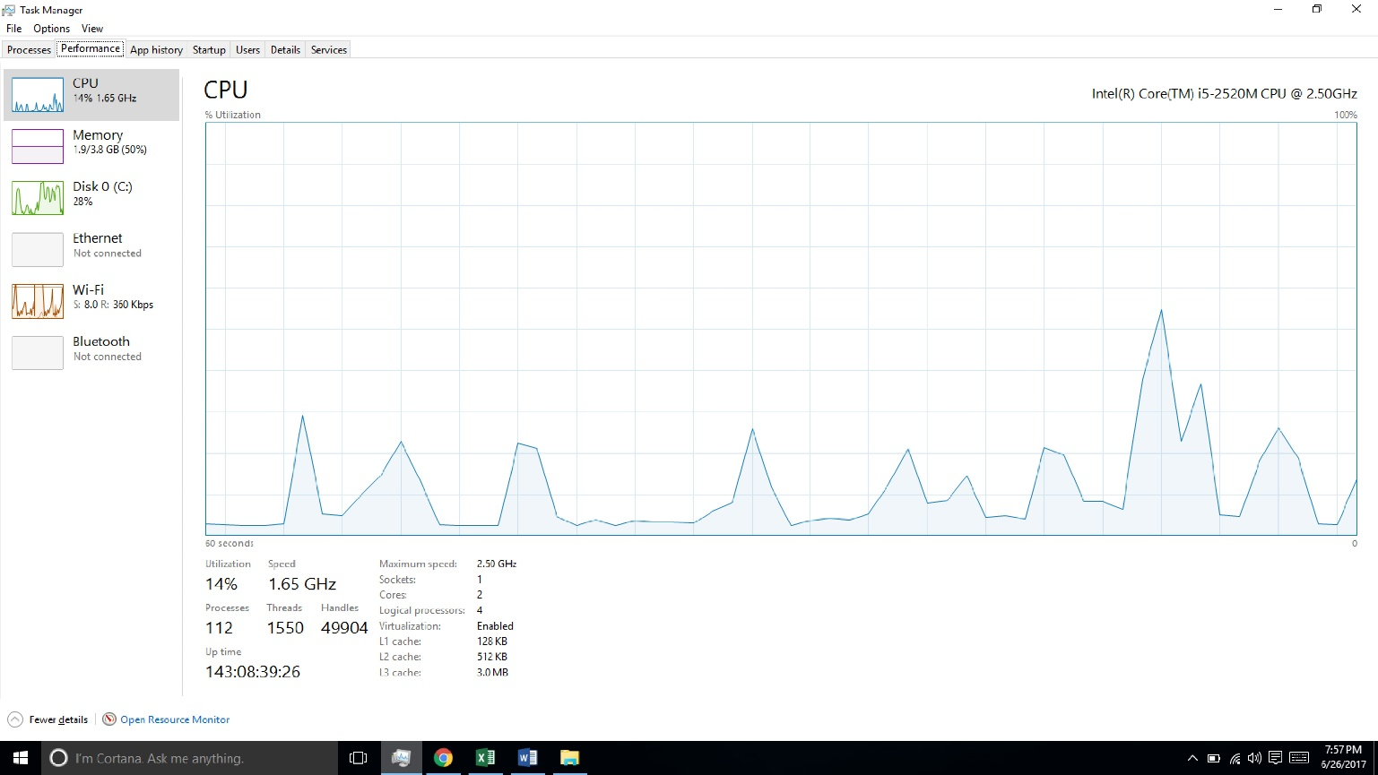
Performance Tuning
Improve performance by removing bottlenecks
OS must provide means of computing and displaying measures of system behavior
For example, “top” program or Windows Task Manager

Slide 88
Tracing
Collects data for a specific event, such as steps involved in a system call invocation
Tools include
strace – trace system calls invoked by a process
gdb – source-level debugger
perf – collection of Linux performance tools
tcpdump – collects network packets

Slide 89
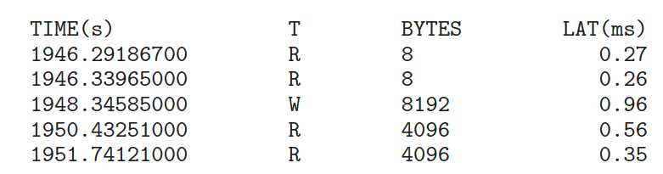
BCC
Debugging interactions between user-level and kernel code nearly impossible without toolset that understands both and an instrument their actions
BCC (BPF Compiler Collection) is a rich toolkit providing tracing features for Linux
See also the original DTrace
For example, disksnoop.py traces disk I/O activity
Many other tools (next slide)

Slide 90
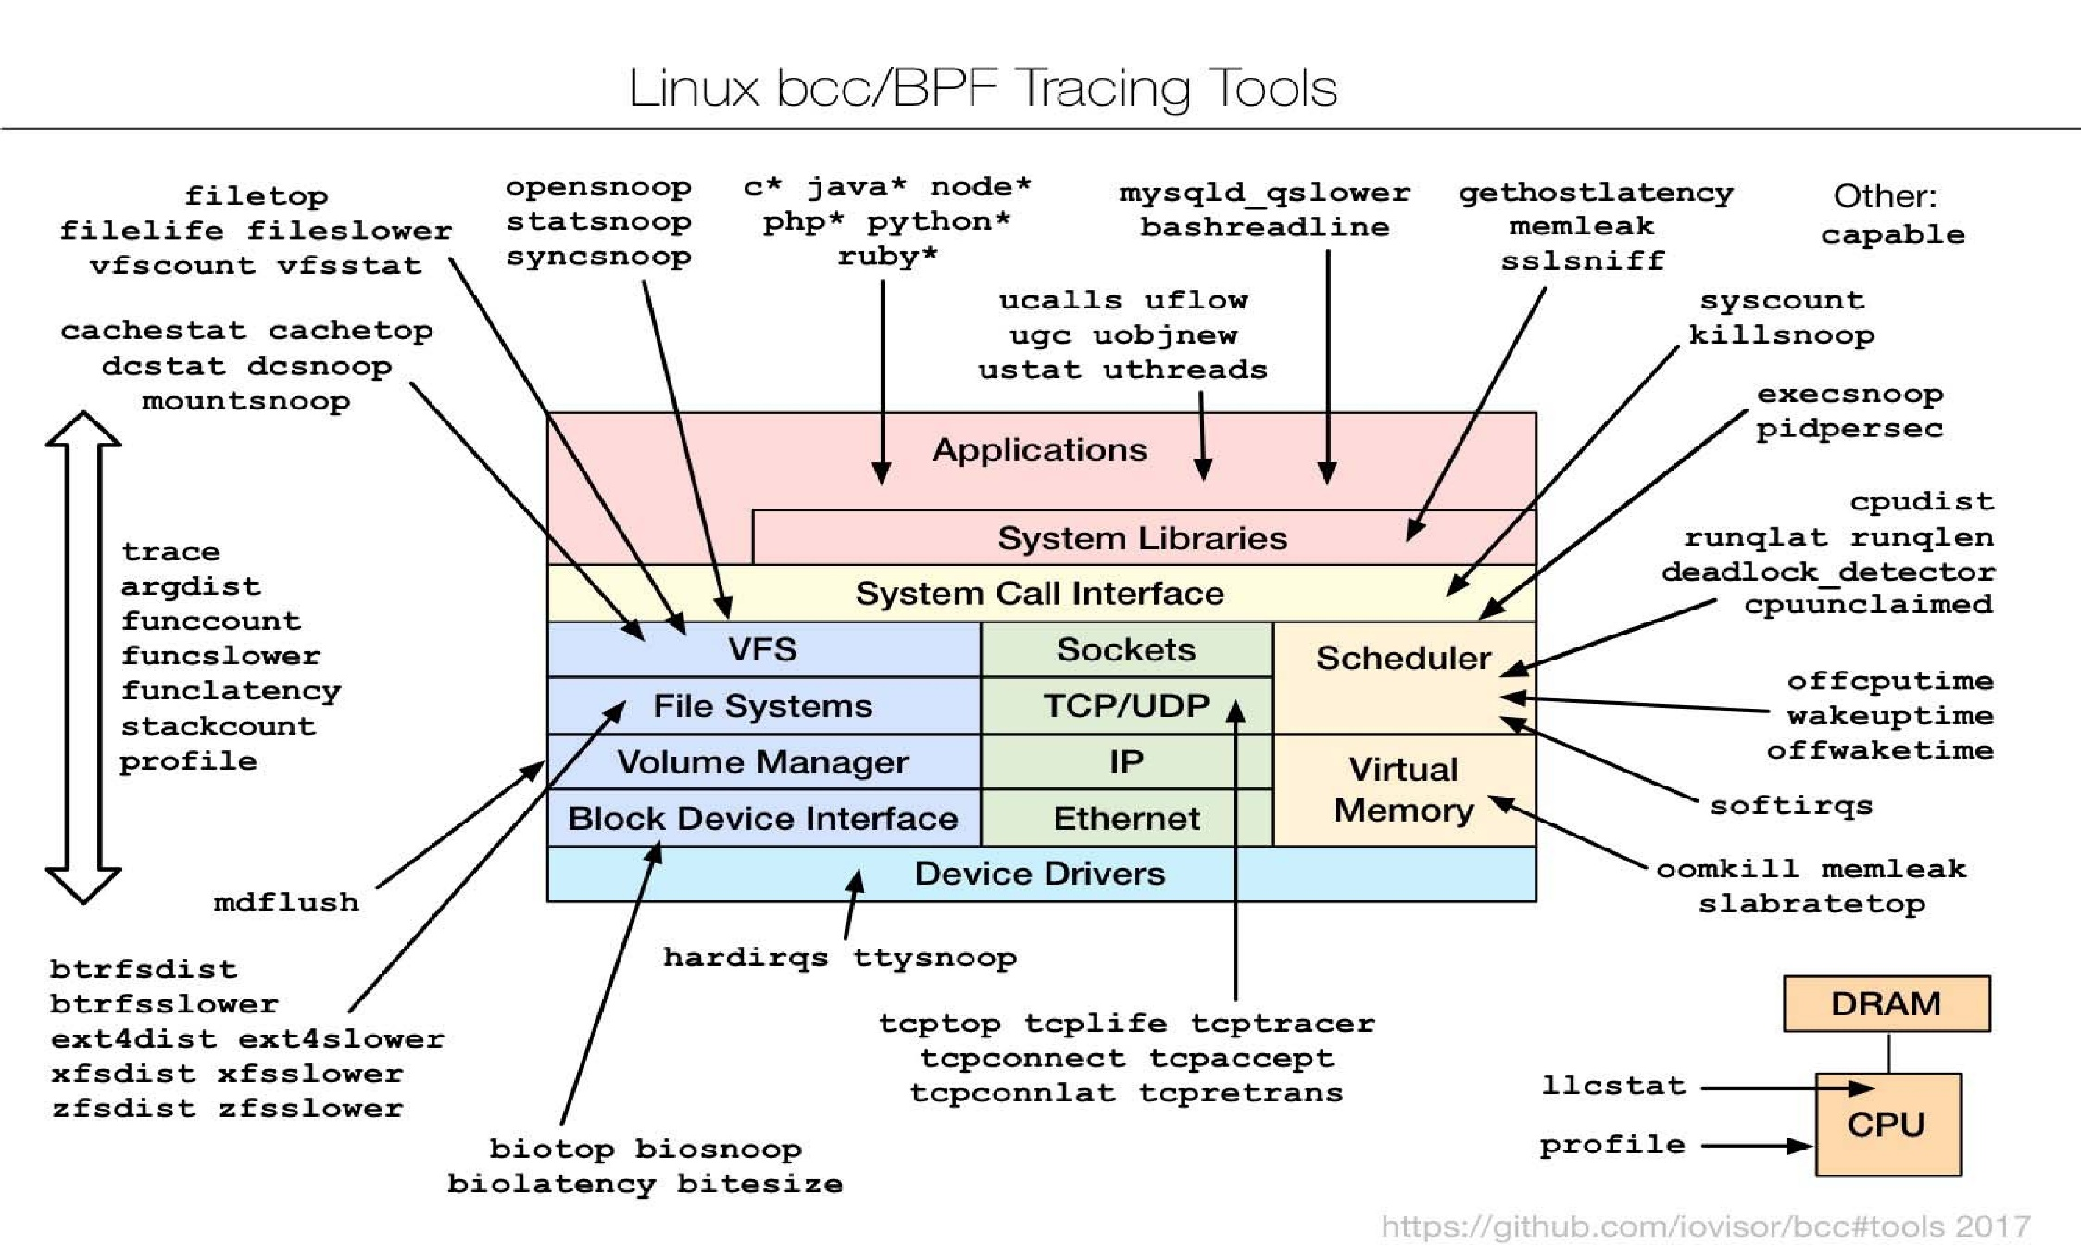
Linux bcc/BPF Tracing Tools

Slide 91
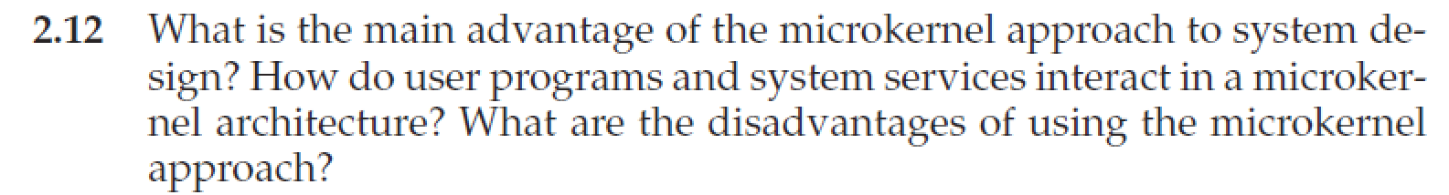
Homework
书后习题2.12、2.14
10月7日晚上12点前发邮件给TA（刘瑞峰，22021258@zju.edu.cn ）
文件名以“学号-姓名-作业x”命名，例如“3170100000-张三-作业2”

Slide 92
End of Chapter 2

